Slide 1

Code Refactoring and Bug Fixing

Slide 2
About me
Name :Geetha Potuka [IN1240707].
Background : Bsc (MSCS)
Why Data Science:
After my Graduation I found interest on IT Domine . I start knowing about current trades and industries happenings ,so finally I applied for Data science course in Innomatics Research Labs.
Work Experience: No
LinkedIn and GitHub:
1.LinkedIn: https://www.linkedin.com/in/p-geetha-reddy-32734a24a/
2.GitHub :https://github.com/pgeethareddy

Slide 3
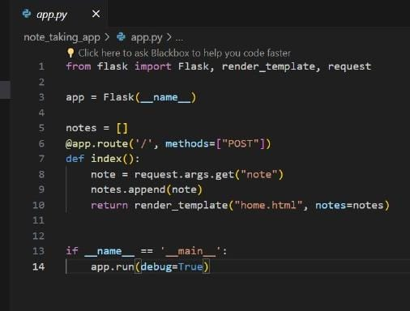
TASK:
Refactor the existing codebase and ensure the proper functioning of the Note Taking Application. Document all identified bugs during the debugging process. Remember, the task is not about recreating the app from scratch. Your goal is to fix the already existing codebase and make the application work as intended.
Before Bug Fixing

Slide 4
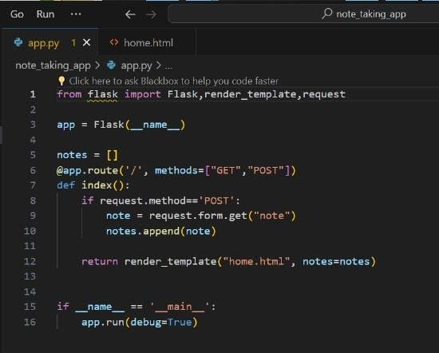
After Bug Fixing:
@app.route(‘/’,methods=[“GET”,”POST”])
1.Add "GET" along with "POST" in the method parameter of the route in the Python Flask application server.
note=request.form.get(“note”)
2.This line of code retrieves the value of the form field named "note" submitted via POST request and assigns it to the variable note.

Slide 5
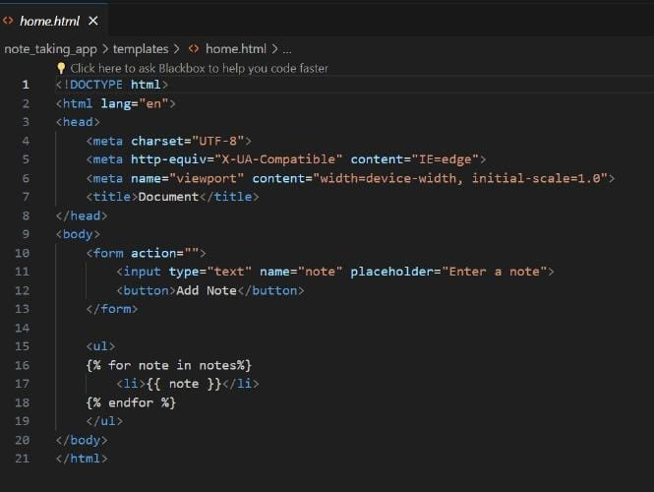
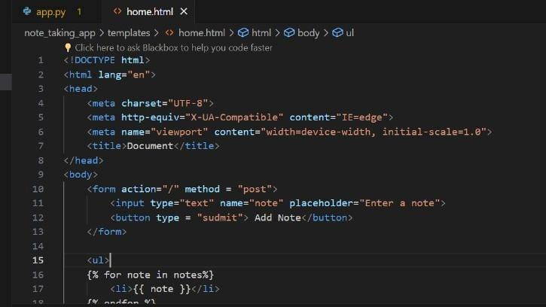
HTML CODE:
Before
After
method=“POST”
1.filling method="post" in the <form> tag indicates that the form data should be sent to the server using the HTTP POST method
Type=“submit”
2.Filling type="submit" in the <button> tag indicates that the button is a submit button within a form, and clicking it will trigger the submission of the form data to the server.

Slide 6
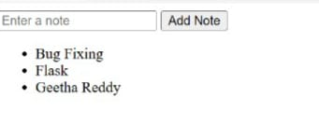
Final Output after Fixing The Bugs:

Slide 7

THANK YOU

